Slide 1
DISNEY+HOTSTAR DATA ANALYSIS
KARTHIGA Elangovan
Badm-mbe-wd-12

Slide 2
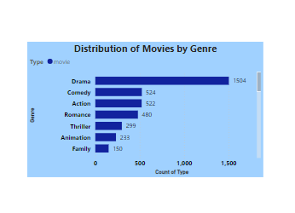
1. Distribution of Movies by Genre

Slide 3
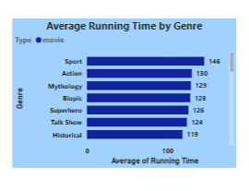
2. Average Running Time by Genre

Slide 4
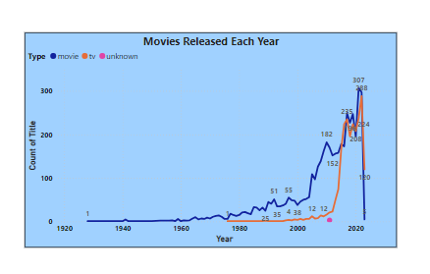
3. Movies Released Each Year

Slide 5
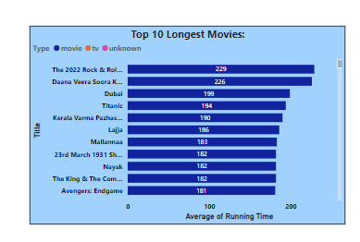
4. Top 10 Longest Movies

Slide 6
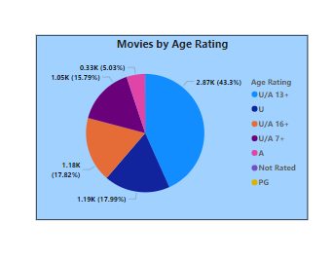
5. Movies by Age Rating

Slide 7
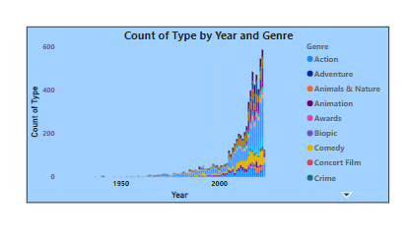
6. Count of Movies by Year and Genre

Slide 8
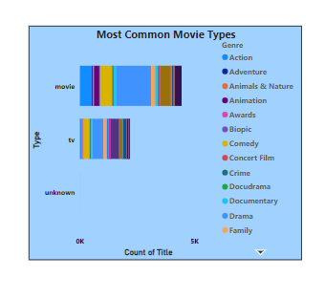
7. Most Common Movie Types

Slide 9
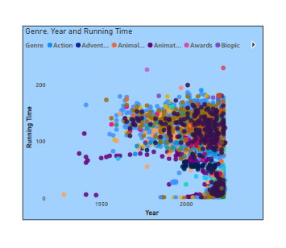
8. Correlation Between Running Time and Year

Slide 10
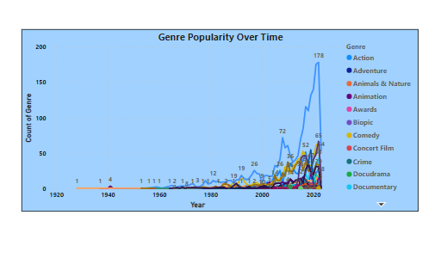
9. Genre Popularity Over Time

Slide 11
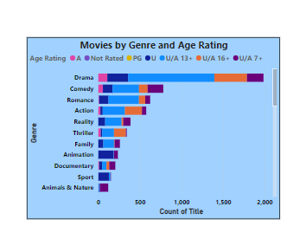
10. Movies by Genre and Age Rating

Slide 12
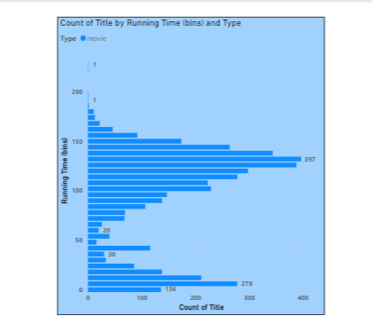
11. Distribution of Running Time

Slide 13
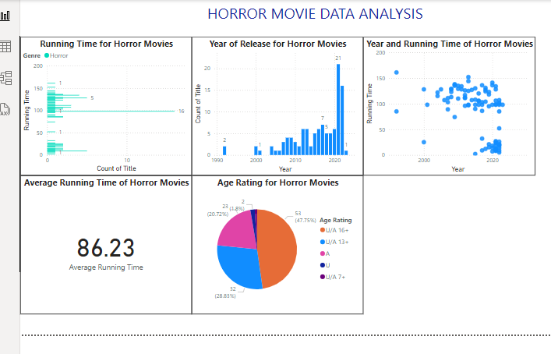
12. Analysis of Specific Genres - Horror

Slide 14
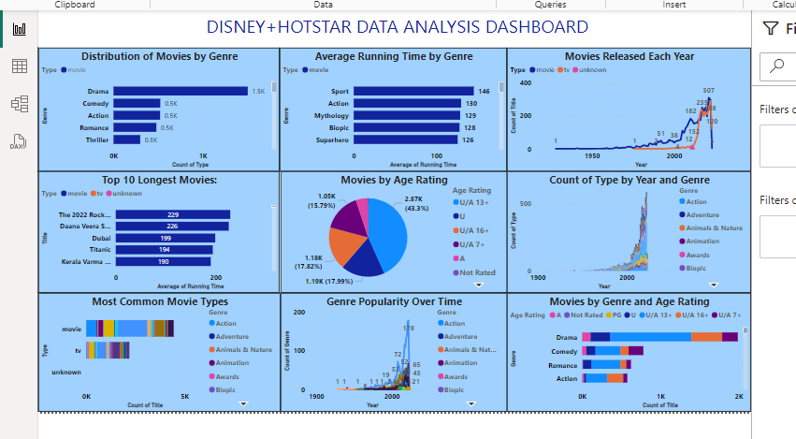
DASHBOARD

Slide 15
Pattern and Trend Analysis:
Popular Genre like Action, Drama and Comedy dominate this platform indicating consistent audience demand for these genres.
Most Movies have family friendly rating (U/A), this shows a strong focus on creating family friendly and widely accessible content.
Most of the Movies Running Time adhering to traditional feature-length standards (90-120 minutes range).
The number of movies released annually has increased over time, showing industry growth.
Horror Movies cater to seasonal (Halloween) and mature audience because these kinds of movies heavily skewed towards A (Adult) ratings.

Slide 16
THANK YOU

